Slide 1
7 Key Principles of Software Testing

Slide 2
Introduction
Software testing is crucial to ensure software quality, reliability, and performance.
The 7 key principles help guide effective and efficient testing processes.

Slide 3
The 7 key principle are as follows:
1. Testing shows the presence of defects
2. Exhaustive Testing is Impossible
3.Early Testing
4.Defect clustering
5.Pesticide paradox
6.Testing Is a context Dependent
7.Absence of Error- Fallacy

Slide 4
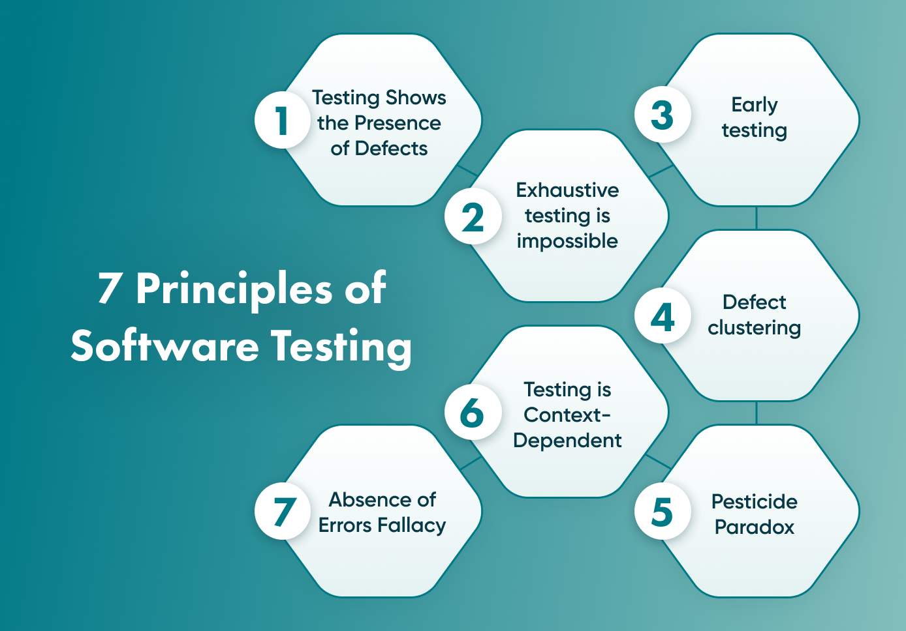
Diagram for 7 key principles

Slide 5
1.Testing Shows Presence of Defects
Testing helps uncover defects but does not guarantee their absence.
The goal is to reduce the number of undiscovered bugs.

Slide 6
2.Exhaustive Testing is Impossible .
It is impractical to test all possible inputs, scenarios, and paths.
Instead, risk-based and prioritized testing strategies are used.

Slide 7
3.Early Testing
Detecting defects early reduces cost and effort.
Testing should begin in the early stages of development.

Slide 8
4.Defect Clustering
A small number of modules often contain most defects (Pareto Principle: 80-20 rule).
Focus testing on high-risk areas.

Slide 9
5. Pesticide Paradox
Repeated execution of the same test cases may no longer find new defects.
Test cases should be regularly reviewed and updated.

Slide 10
6.Testing is Context-Dependent
Different software requires different testing strategies.
Example: A banking application vs. a gaming application.

Slide 11
7.Absence-of-Errors Fallacy
Finding and fixing defects does not guarantee a useful product.
Software must also meet user needs and business requirements.

Slide 12
Conclusion
These principles guide effective testing and improve software quality.
Applying them ensures better defect detection, cost reduction, and higher user satisfaction.

Slide 13
Thank you!

